Slide 1
Monitoring a Data Guard Configuration

Slide 2
Objectives
After completing this lesson, you should be able to:
  Use Enterprise Manager Grid Control to monitor the configuration
  Use DGMGRL to view the configuration status
Notes:
Oracle Database 11g: Data Guard Administration 8 - <number>

Slide 3
Monitoring the Data Guard Configuration by Using Enterprise Manager Grid Control
On the Data Guard Overview page, you can:
  View the Standby Progress Summary graph that shows the transport lag and the apply lag
  Access additional performance and configuration information
    Performance Overview page: Information about data archived and applied, standby database progress, and log services
    Log File Details page: Information about the primary database online redo log file
  Perform a Verify operation
Notes:
Oracle Database 11g: Data Guard Administration 8 - <number>
Monitoring the Data Guard Configuration by Using Enterprise Manager Grid Control
Enterprise Manager Grid Control provides a graphical user interface for monitoring the Data Guard configuration. The following pages in this lesson describes the information that you can view on the Data Guard Overview page and its related pages.

Slide 4
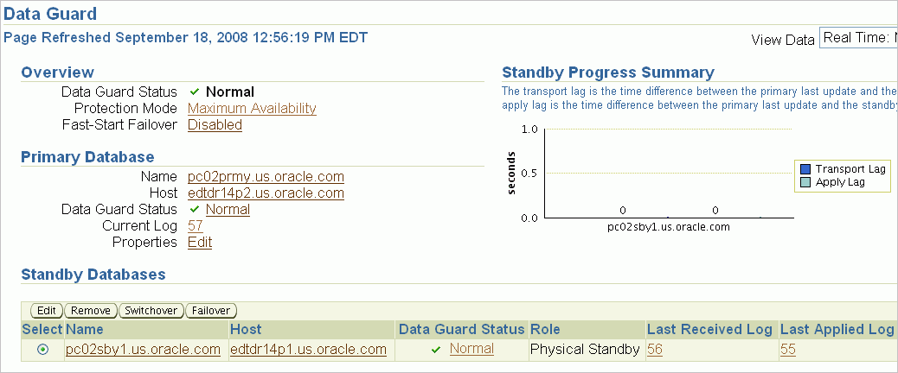
Viewing the Data Guard Configuration Status
Notes:
Oracle Database 11g: Data Guard Administration 8 - <number>
Viewing the Data Guard Configuration Status
On the Data Guard Overview page, you can view the status of the primary database and the standby databases in a configuration.
In the Standby Progress Summary section, you can view information about transport and apply lags.
The apply lag shows the approximate number of seconds that the standby database is behind the primary database. A large apply lag may indicate that Redo Apply needs to be tuned or that there is a gap.
The transport lag shows the approximate number of seconds of redo not yet available on the standby database and provides an indication of potential data loss in the event of a disaster. A significant transport lag may be caused by:
A gap in the redo
Network bandwidth constraints
An overloaded log writer network server (LNS) process on the primary database
Redo generation that is faster than the LNS and network can handle
I/O issues on the remote file server (RFS) process side
An overloaded RFS process
An inadequate number of standby redo log files causing the RFS process to stall or to use archived log files

Slide 5
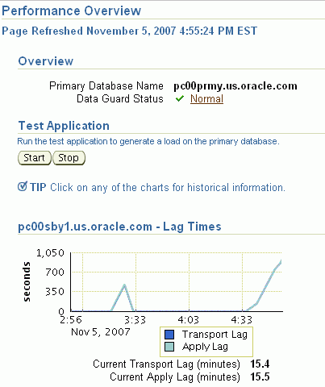
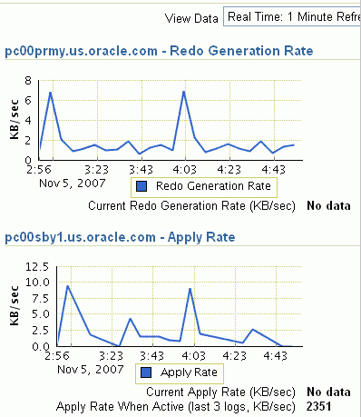
Monitoring Data Guard Performance
Notes:
Oracle Database 11g: Data Guard Administration 8 - <number>
Viewing Data Guard Performance
Click Performance Overview in the Performance section of the Data Guard Overview page to access the Performance Overview page.
The Performance Overview page displays detailed performance-related statistics for the Data Guard configuration. The performance charts provide a graphical summary of all redo log activity in the configuration. You can set the collection interval (which causes the charts to be refreshed) to determine the rate of sampling of the primary database in the View Data field.
The following charts display performance information for all databases in the configuration:
Redo Generation Rate: Redo generation rate (in KB per second).
Lag Times: Approximate amount of potential data loss. Lag Times -- Shows the Transport Lag (the approximate number seconds of redo not yet available on the standby database) and Apply Lag (The approximate number of seconds the standby is behind the primary database).
Apply Rate: Data applied on each standby database in the configuration. Each point on the chart represents the amount of redo data that has been applied since the last time it was refreshed.
Click any of the charts to obtain historical information.

Slide 6
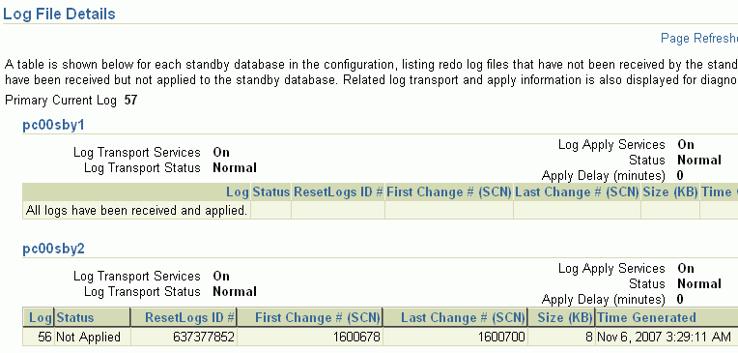
Viewing Log File Details
Notes:
Oracle Database 11g: Data Guard Administration 8 - <number>
Viewing Log File Details
The Log File Details page displays information about the log files that were generated on the primary database and received by the standby database. The information is presented in a tabular format for each standby database in the configuration. The table contains the following columns:
Log: Contains the log file sequence number
Status: “Partially Applied,” “Not Applied,” “Not Received”
ResetLogs ID: Identifier that changes after a terminal recovery and an open with RESETLOGS
First Change # (SCN): First system change number (SCN) in the log file
Last Change # (SCN): Last SCN in the log file
Size (KB): Size of the log file
Time Generated: Time at which the log file was generated
Time Completed: Time at which the log file completed

Slide 7


Enterprise Manager Metrics and Alerts
  Metrics: Units of measurement that are used to assess the health of your system
  Thresholds: Boundary values against which monitored metric values are compared
  Alert: Indication that is generated when a threshold is reached
Notes:
Oracle Database 11g: Data Guard Administration 8 - <number>
Enterprise Manager Metrics and Alerts
Metrics are units of measurement that are used to assess the health of your system. Each target comes with a predefined set of metrics.
Metric thresholds are boundary values against which monitored metric values are compared. Some thresholds are predefined by Oracle; others are not.
When a threshold is reached, an alert is generated to indicate that a particular condition was encountered. An alert is triggered when one of the following conditions is true:
A threshold is reached.
An alert was cleared.
The availability of a monitored service changes.
A specific condition occurs. (Example: An alert is triggered when an error message is written to a database alert log file.)
Alerts are detected through a polling-based mechanism by checking for the monitored condition from a separate process at regular, predefined intervals.
You can associate an alert with a notification, with the automatic execution of a job, and so on.

Slide 8
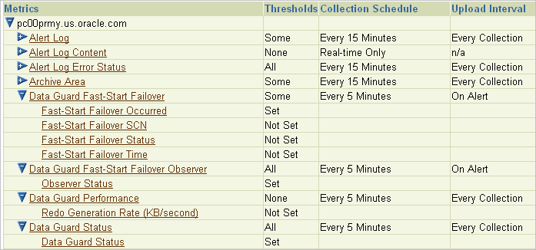
Data Guard Metrics
Enterprise Manager provides Data Guard metrics:
Notes:
Oracle Database 11g: Data Guard Administration 8 - <number>
Data Guard Metrics
You can use Enterprise Manager to monitor status and log file activity. In addition, Enterprise Manager automatically monitors the status and archived redo log file activity on the primary and standby databases and provides the following metrics:
Data Guard Fast-Start Failover: When fast-start failover is enabled, this metric generates a critical alert on the new primary database if a fast-start failover occurs.
Data Guard Fast-Start Failover Observer: This metric displays the current status of the fast-start failover observer. A down status triggers an alert. The observer is a separate OCI client-side component that monitors the availability of the primary database in a fast-start failover configuration. Fast-start failover is discussed in the lesson titled “Enabling Fast-Start Failover.”
Data Guard Performance: This metric provides alerts for performance that is related to redo log activity in the configuration.
Data Guard Status: This metric checks the status of each database in the broker configuration and triggers a warning or critical alert if necessary.
You can set up Email Services to send you a message if a metric is triggered. See Oracle Data Guard Broker for detailed information.
Note: These metrics are seen on the primary database only.

Slide 9
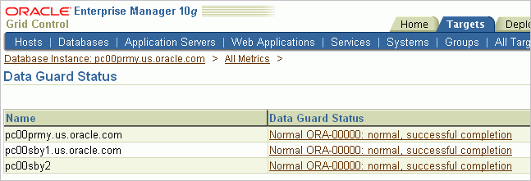
Managing Data Guard Metrics
  Configure notification methods.
  View the All Metrics page.
  Set or change Data Guard metric thresholds.
Notes:
Oracle Database 11g: Data Guard Administration 8 - <number>
Managing Data Guard Metrics
You can specify that an email notification be sent to you when a Data Guard metric is triggered.
To configure the notification:
1. Configure notification methods in Enterprise Manager.
a. Click Setup at the top of the Database Home page.
b. Click Notification Methods on the Setup page.
c. Enter the appropriate information in the Mail Server section and click Apply. Next, click Test Mail Servers to verify your configuration.
2. View the All Metrics page by clicking All Metrics in the Related Links section on the Database Home page. Next, view the Oracle Enterprise Manager metrics, including the metrics for Data Guard.
3. Set or change Data Guard metric thresholds by clicking “Metric and Policy Settings” in the Related Links section on the All Metrics page to access the “Metric and Policy Settings” page. On this page, you can set and change the Data Guard Status metric on the Metrics Thresholds tab.
If a metric condition is triggered or a threshold value is exceeded, an alert is issued. Click Data Guard Status on the All Metrics page to view triggered metrics. Click the metric, and then click a particular database to see details.

Slide 10
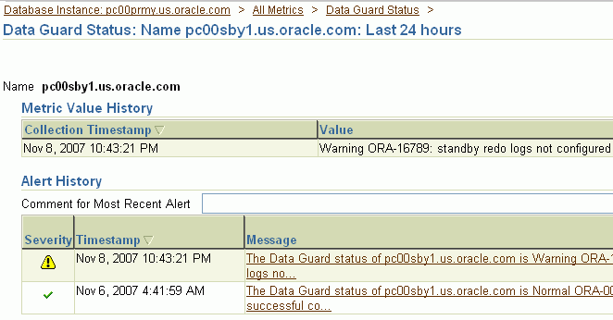
Viewing Metric Value History
Notes:
Oracle Database 11g: Data Guard Administration 8 - <number>
Viewing Metric Value History
When an alert is triggered, you can view detailed information by clicking the link in the Message field.

Slide 11
Viewing Data Guard Diagnostic Information
  The Data Guard broker records information in:
    Oracle database alert log files
    Data Guard broker log files
  Database status information is available by issuing the SHOW DATABASE command.
  Use the following database properties to obtain additional information:
    StatusReport
    LogXptStatus
    InconsistentProperties
    InconsistentLogXptProps
DGMGRL> SHOW DATABASE 'pc00prmy' 'StatusReport';
Notes:
Oracle Database 11g: Data Guard Administration 8 - <number>
Viewing Data Guard Diagnostic Information
The Data Guard broker records activity information in the Oracle database alert log file and in the Data Guard broker log files. The broker log files are named drc<$ORACLE_SID>.log and are located in the same directory as the alert log file.
You can obtain information about the health of the database (referred to as the database status) by issuing the SHOW DATABASE DGMGRL command.
The following monitorable database properties can be used to query the database status:
StatusReport: Lists all problems detected by the broker during a database health check
LogXptStatus: Lists all log transport errors detected on all instances of the primary database
InconsistentProperties: Lists all properties that have inconsistent values between the broker configuration file and the database settings
InconsistentLogXptProps: Lists all redo transport–related properties of standby databases that have inconsistent values between the broker configuration file and the redo transport settings

Slide 12
Using Monitorable Database Properties to Identify a Failure
  Check the configuration status:
  Check the database status:
  Check the StatusReport monitorable database property:
  Check additional monitorable database properties as appropriate.
DGMGRL> SHOW CONFIGURATION;
DGMGRL> SHOW DATABASE 'pc00prmy';
DGMGRL> SHOW DATABASE 'pc00prmy' 'StatusReport';
Notes:
Oracle Database 11g: Data Guard Administration 8 - <number>
Using Monitorable Database Properties to Identify a Failure
You can use the SHOW CONFIGURATION and SHOW DATABASE commands and the monitorable database properties to identify and determine an appropriate resolution for a failure in your Database Guard configuration.
1. Use the SHOW CONFIGURATION command to check the status of the configuration.
The status is an aggregated status of all databases and instances in the broker configuration. If everything is working properly in the configuration, the output of this command with respect to status is "SUCCESS." If there is a problem in the configuration, you receive an error message.
2. If you receive an error message when you execute the SHOW CONFIGURATION command, execute the SHOW DATABASE command for each database to determine which database in the configuration has an error or warning.
3. You can then view the StatusReport monitorable database property for the database that is in error to view a list of the warnings and errors for the database.
4. After viewing the StatusReport output, you can view the other monitorable database properties (InconsistentProperties, LogXptStatus, InconsistentLogXptProps) as appropriate.

Slide 13
Using the SHOW CONFIGURATION DGMGRL Command to Monitor the Configuration
Use the SHOW CONFIGURATION command to display a brief description of the configuration status:
DGMGRL> show configuration
Configuration
Name: DGConfig1
Enabled: YES
Protection Mode: MaxPerformance
Databases:
pc00prmy - Primary database
pc00sby1 - Physical standby database
pc00sby2 - Physical standby database
Fast-Start Failover: DISABLED
Current status for "DGConfig1":
SUCCESS
Notes:
Oracle Database 11g: Data Guard Administration 8 - <number>
Using the SHOW CONFIGURATION DGMGRL Command to Monitor the Configuration
The SHOW CONFIGURATION DGMGRL command provides a brief description of the configuration, including the state of the configuration, the protection mode, and the state of fast-start failover. The display also lists the databases that are part of the configuration.
In addition, the current status of the configuration is provided; if there is a problem with the configuration, a warning message appears. You can investigate the problem as described on the following slides.

Slide 14
Using the SHOW DATABASE DGMGRL Command to Monitor the Configuration
Use the SHOW DATABASE command to display a brief summary of the database:
DGMGRL> show database pc00sby1
Database
Name: pc00sby1
OEM Name: pc00sby1.us.oracle.com
Role: PHYSICAL STANDBY
Enabled: YES
Intended State: APPLY-ON
Instance(s):
pc00sby1
Current status for "pc00sby1":
SUCCESS
Notes:
Oracle Database 11g: Data Guard Administration 8 - <number>
Using the SHOW DATABASE DGMGRL Command to Monitor the Configuration
Use the SHOW DATABASE VERBOSE DGMGRL command to view a brief summary of the specified database in the broker configuration.

Slide 15
Using the SHOW DATABASE VERBOSE DGMGRL Command to Monitor the Configuration
Use the SHOW DATABASE VERBOSE command to display all property values for a database:
DGMGRL> show database verbose pc00sby1
Database
Name: pc00sby1
OEM Name: pc00sby1.us.oracle.com
Role: PHYSICAL STANDBY
Enabled: YES
Intended State: APPLY-ON
Instance(s):
pc00sby1
Properties:
DGConnectIdentifier = 'pc00sby1'
ObserverConnectIdentifier = ''
LogXptMode = 'ASYNC'
…
Notes:
Oracle Database 11g: Data Guard Administration 8 - <number>
Using the SHOW DATABASE VERBOSE DGMGRL Command to Monitor the Configuration
Use the SHOW DATABASE VERBOSE DGMGRL command to view a brief summary and the properties of the specified database.

Slide 16
Viewing Standby Redo Log Information in V$LOGFILE
SQL> SELECT group#, status, member
2 FROM v$logfile
3 WHERE type = 'STANDBY';
GROUP# STATUS MEMBER
------ ------ ------------------------------------------
4 /u01/app/oracle/oradata/pc00prmy/srl01.log
5 /u01/app/oracle/oradata/pc00prmy/srl02.log
6 /u01/app/oracle/oradata/pc00prmy/srl03.log
7 /u01/app/oracle/oradata/pc00prmy/srl04.log
Notes:
Viewing Standby Redo Log Information in V$LOGFILE
Obtain information about the standby redo log by querying V$LOGFILE. The STATUS column contains the following possible values:
INVALID: The file is inaccessible.
STALE: The file contents are incomplete.
DELETED: The file is no longer used.
Null: The file is in use.

Slide 17
Viewing Standby Redo Log Information in V$STANDBY_LOG
SQL> SELECT group#, dbid, archived, status
2 FROM v$standby_log;
GROUP# DBID ARC STATUS
---------- -------------- --- ----------
4 UNASSIGNED NO UNASSIGNED
5 3303427449 YES ACTIVE
6 UNASSIGNED YES UNASSIGNED
7 UNASSIGNED YES UNASSIGNED
Notes:
Viewing Standby Redo Log Information in V$STANDBY_LOG
Query V$STANDBY_LOG to obtain information about the standby redo log. Columns of interest include:
GROUP#: Log group number.
DBID: Database ID of the primary database to which the standby redo log file is assigned. If the standby redo log file is unassigned, the value UNASSIGNED is displayed.
ARCHIVED: Contains a value of YES or NO. See STATUS for additional information.
STATUS: Contains a value of UNASSIGNED or ACTIVE.
UNASSIGNED: If the value of ARCHIVED is NO, the standby redo log was archived and is again available. If the value of ARCHIVED is YES, the standby redo log was never used and is available.
ACTIVE: If the value of ARCHIVED is NO, the standby redo log is complete and waiting to be archived. If the value of ARCHIVED is YES, the standby redo log is currently being written to and is not ready to be archived.

Slide 18
Identifying Destination Settings
SQL> SELECT dest_id,valid_type,valid_role,valid_now
2 FROM v$archive_dest;
DEST_ID VALID_TYPE VALID_ROLE VALID_NOW
------- --------------- ------------ --------------
1 ALL_LOGFILES ALL_ROLES YES
2 STANDBY_LOGFILE STANDBY_ROLE WRONG VALID_TYPE
3 ONLINE_LOGFILE STANDBY_ROLE WRONG VALID_ROLE
4 ALL_LOGFILES ALL_ROLES UNKNOWN
5 ALL_LOGFILES ALL_ROLES UNKNOWN
6 ALL_LOGFILES ALL_ROLES UNKNOWN
7 ALL_LOGFILES ALL_ROLES UNKNOWN
8 ALL_LOGFILES ALL_ROLES UNKNOWN
9 ALL_LOGFILES ALL_ROLES UNKNOWN
10 ALL_LOGFILES ALL_ROLES UNKNOWN
11 ALL_LOGFILES ALL_ROLES YES
11 rows selected.
Notes:
Oracle Database 11g: Data Guard Administration 8 - <number>
Identifying Destination Settings
The VALID_NOW column in V$ARCHIVE_DEST indicates whether the archive log destination is used. The column contains the following values:
YES: The archive log destination is appropriately defined for the current database role.
WRONG VALID_TYPE: The archive log destination is appropriately defined for the current database role but cannot be used. For example, LOG_ARCHIVE_DEST_2 is set to (STANDBY_LOGFILES,STANDBY_ROLE), but WRONG VALID_TYPE is returned because this standby destination does not have an implemented standby redo log.
WRONG VALID_ROLE: The archive log destination is not appropriately defined for the current database role. For example, LOG_ARCHIVE_DEST_3 is set to (ONLINE_LOGFILES,STANDBY_ROLE), but WRONG VALID_ROLE is returned because this destination is currently running in the primary database role.
UNKNOWN: The archive log destination is not defined.
The VALID_TYPE and VALID_ROLE columns are the values from the VALID_FOR attribute that is specified for each archive log destination.

Slide 19
Setting the LOG_ARCHIVE_TRACE
Initialization Parameter
  LOG_ARCHIVE_TRACE is optional and is used for diagnostic purposes.
  Set this parameter to an integer value to see the progression of redo log archiving to the standby system.
    On the primary database, processes write an audit trail of the archived logs sent to the standby system into a trace file.
    On the standby database, processes write an audit trail of the archived logs received from the primary database into a trace file.
  Trace files are written to the Automatic Diagnostic Repository, the location of which is specified by the DIAGNOSTIC_DEST initialization parameter.
Notes:
Oracle Database 11g: Data Guard Administration 8 - <number>
Setting the LOG_ARCHIVE_TRACE Initialization Parameter
Set this parameter to trace the transmission of redo data to the standby system.
To enable, disable, or modify the LOG_ARCHIVE_TRACE parameter in a primary database, issue the ALTER SYSTEM SET LOG_ARCHIVE_TRACE=trace_level statement while the database is open or mounted. If you change the value of this parameter dynamically with an ALTER SYSTEM statement, the changes take effect at the start of the next archive operation.
See Oracle Data Guard Concepts and Administration for additional information.

Slide 20
Notes:
Setting the LOG_ARCHIVE_TRACE Initialization Parameter (continued)
The integer values for the LOG_ARCHIVE_TRACE parameter represent levels of tracing data. In general, a higher level indicates more detailed information. You can combine tracing levels by setting the value of the LOG_ARCHIVE_TRACE parameter to the sum of the individual levels. For example, setting the parameter to 6 generates level 2 and level 4 trace output.
The following integer levels are available:

Slide 21
Monitoring Redo Apply by Querying V$MANAGED_STANDBY
SQL> SELECT process, status, group#, thread#, sequence#
2 FROM v$managed_standby
3 order by process, group#, thread#, sequence#;
PROCESS STATUS GROUP# THREAD# SEQUENCE#
--------- ------------ ---------- ---------- ----------
ARCH CLOSING 4 1 142
ARCH CLOSING 4 1 146
ARCH CLOSING 4 1 148
ARCH CLOSING 5 1 141
ARCH CLOSING 5 1 147
MRP0 APPLYING_LOG N/A 1 149
RFS IDLE 2 1 149
RFS IDLE N/A 0 0
RFS IDLE N/A 0 0
Notes:
Monitoring Redo Apply by Querying V$MANAGED_STANDBY
Query V$MANAGED_STANDBY to view information about Redo Apply and redo transport status on a physical standby database. See the Oracle Database Reference for detailed information about the values in each column.

Slide 22
Evaluating Redo Data by Querying V$DATAGUARD_STATS
SQL> SELECT name, value, time_computed
2 FROM v$dataguard_stats;
NAME VALUE TIME_COMPUTED
------------------------- --------------- --------------
apply finish time +00 00:00:00.0 13-FEB-2008 02:44:21
apply lag +00 00:00:00 13-FEB-2008 02:44:21
estimated startup time 12 13-FEB-2008 02:44:21
standby has been open N 13-FEB-2008 02:44:21
transport lag +00 00:00:00 13-FEB-2008 02:44:21
Notes:
Evaluating Redo Data by Querying V$DATAGUARD_STATS
Query V$DATAGUARD_STATS to evaluate each standby database in terms of the currency of the data in the standby database and the time it takes to perform a role transition if all available redo data is applied to the standby database.
V$DATAGUARD_STATS displays the amount of redo data generated by the primary database that is not yet available on the standby database. This information enables you to determine how much redo data would be lost if the primary database were to crash when you queried this view.
See the Oracle Database Reference for detailed information about column values.

Slide 23
Viewing Data Guard Status Information by Querying V$DATAGUARD_STATUS
SQL> SELECT timestamp, facility, dest_id, message_num,
2 error_code, message
3 FROM v$dataguard_status
4 ORDER by timestamp;
TIMESTAMP FACILITY DEST_ID MESSAGE_NUM ERROR_CODE
--------- --------------- ------- ----------- ----------
MESSAGE
--------------------------------------------------------
13-FEB-08 Log Apply Servi 0 562 0
Media Recovery Waiting for thread 1 sequence 151
13-FEB-08 Remote File Ser 0 563 0
Primary database is in MAXIMUM AVAILABILITY mode
13-FEB-08 Remote File Ser 0 564 0
Standby controlfile consistent with primary
13-FEB-08 Remote File Ser 0 565 0
RFS[25]: Successfully opened standby log 5: '/u01/app/oracle/oradata/pc00sby1/srl02.log'
Notes:
Viewing Data Guard Status Information by Querying V$DATAGUARD_STATUS
Query V$DATAGUARD_STATUS to view messages that were recently written to the alert log or server process trace files that concern physical standby databases or redo transport services for all standby database types.
See the Oracle Database Reference for detailed information about column values.

Slide 24
Viewing V$LOGSTDBY_TRANSACTION
Query V$LOGSTDBY_TRANSACTION to view information
about all transactions that are actively being processed
by SQL Apply:
SQL> SELECT primary_xid, type,
2 mining_status, apply_status
3 FROM v$logstdby_transaction;
Notes:
Viewing V$LOGSTDBY_TRANSACTION
Query V$LOGSTDBY_TRANSACTION to view information about the transactions that are actively being processed by SQL Apply. The transaction identifiers shown in this view correspond to transaction identifiers assigned at the primary database and do not correspond to the transactions that are active at the logical standby database. Query the V$TRANSACTION view on the logical standby database for information about transactions that are active in the logical standby database, including those that were created as part of SQL Apply.

Slide 25
Summary
In this lesson, you should have learned how to:
  Use Enterprise Manager Grid Control to monitor the configuration
  Use DGMGRL to view the configuration status
Notes:
Oracle Database 11g: Data Guard Administration 8 - <number>

Slide 26
Practice 8: Overview
This practice covers the following topics:
  Verifying the broker configuration
  Viewing log file details
  Checking the configuration status
  Checking the database status
Notes:
Oracle Database 11g: Data Guard Administration 8 - <number>

